Slide 1
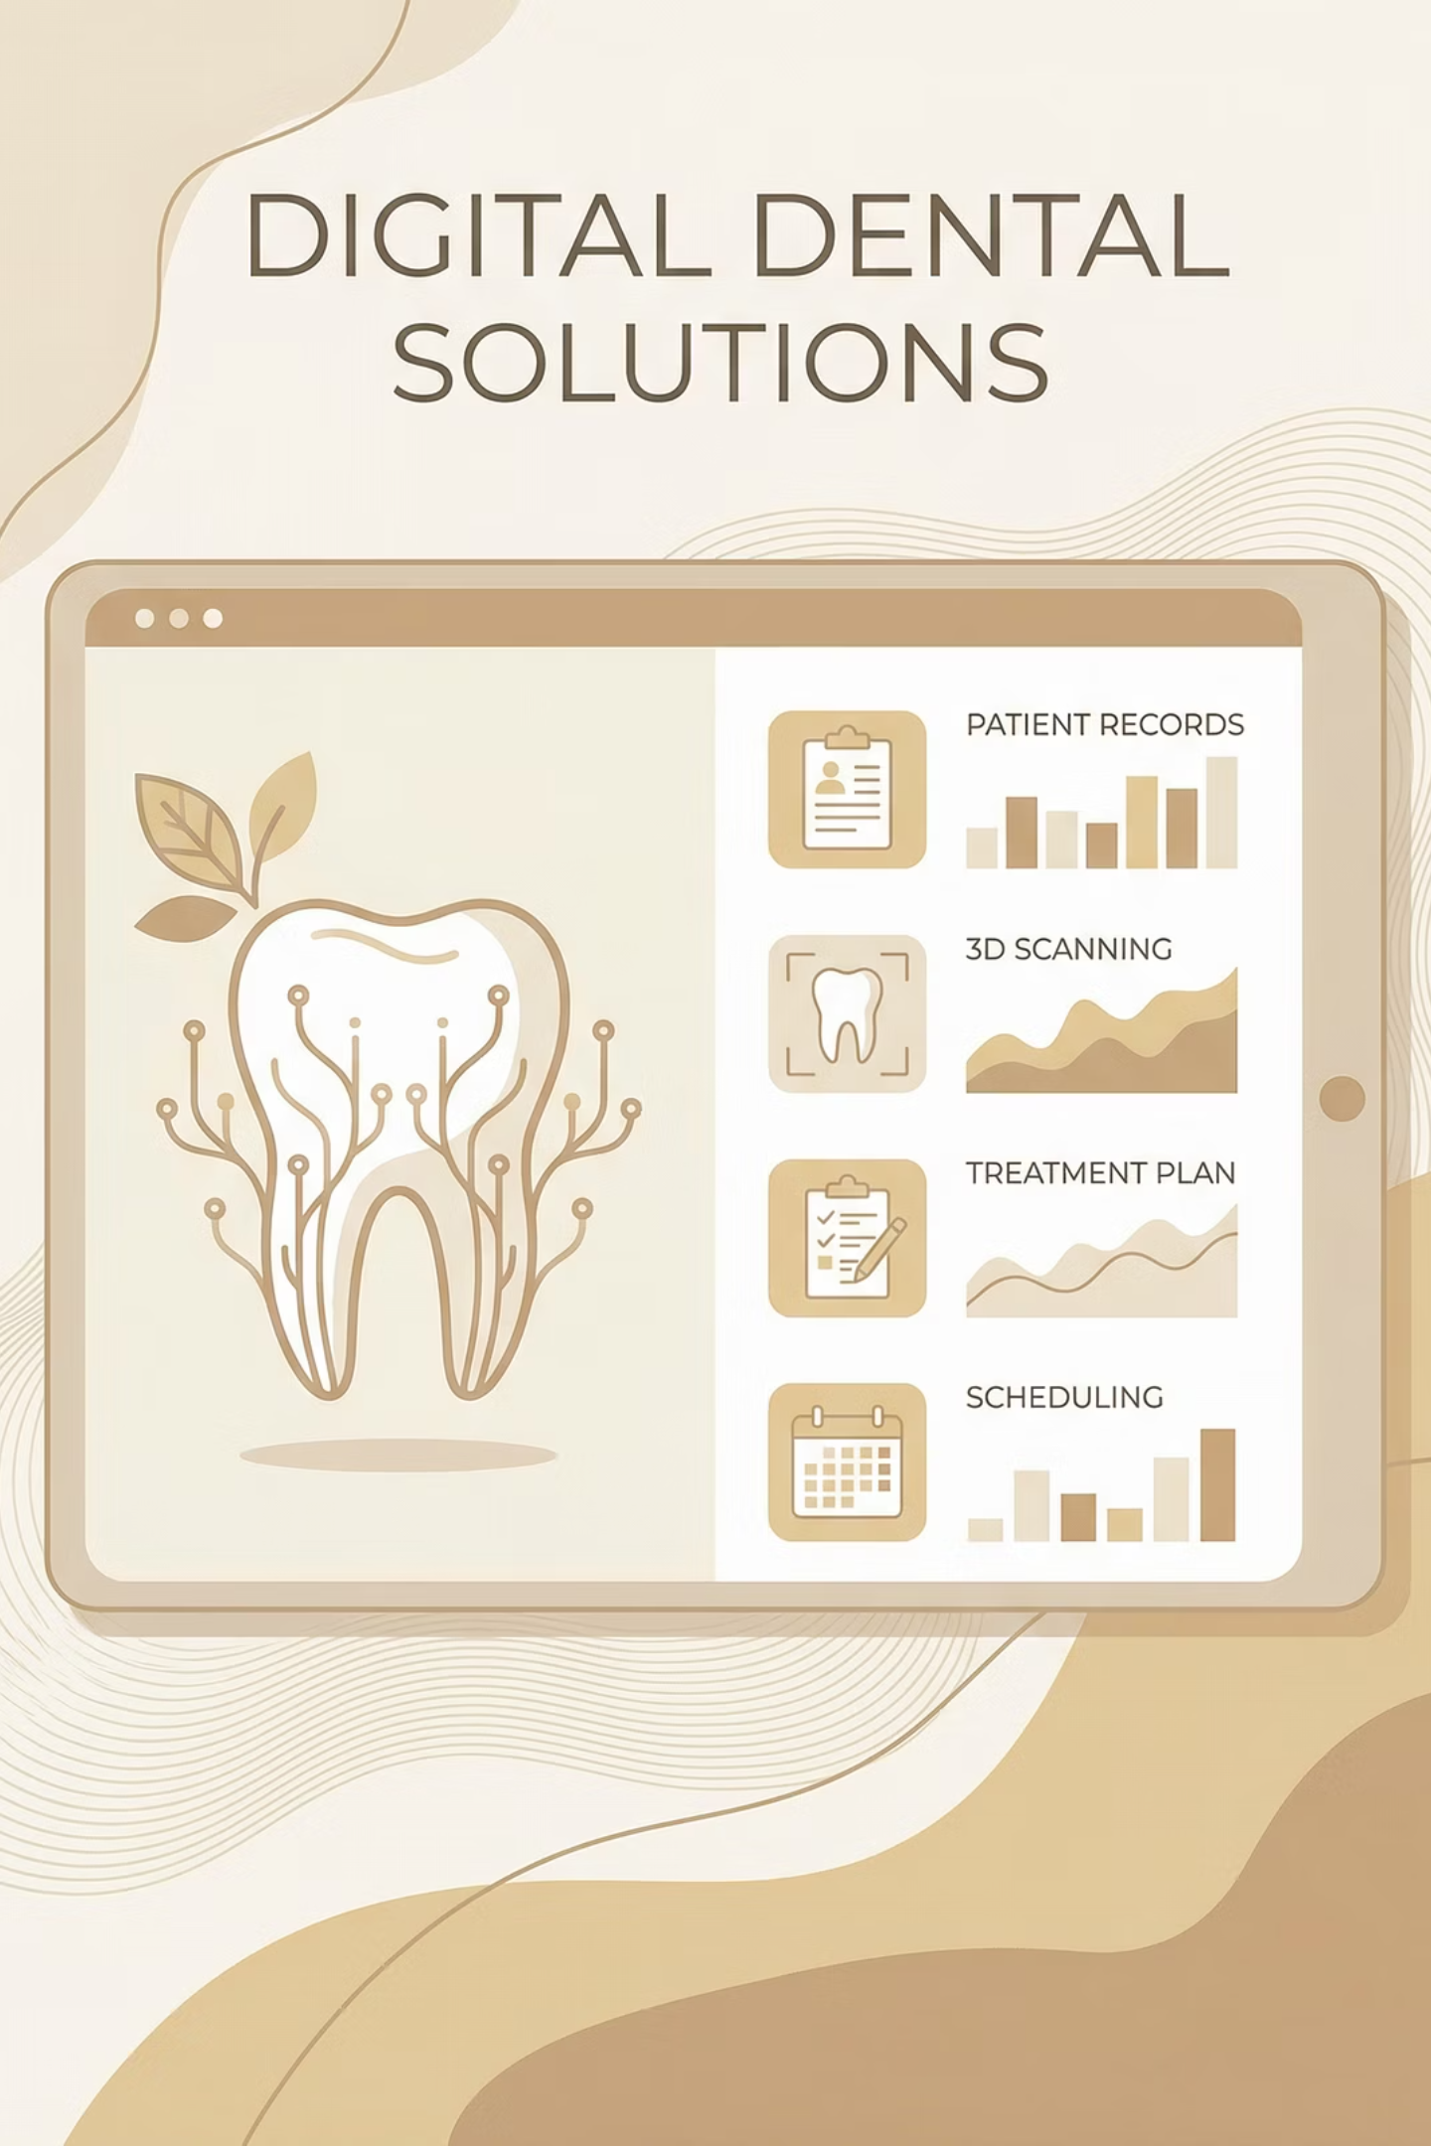
E-DENTIST
A Comprehensive Dental Care Solution
Presented by Abu Sadat Al Rafi, Md. Ahsan Kabir, and Abu Ekhtiar Tawhid

Slide 2
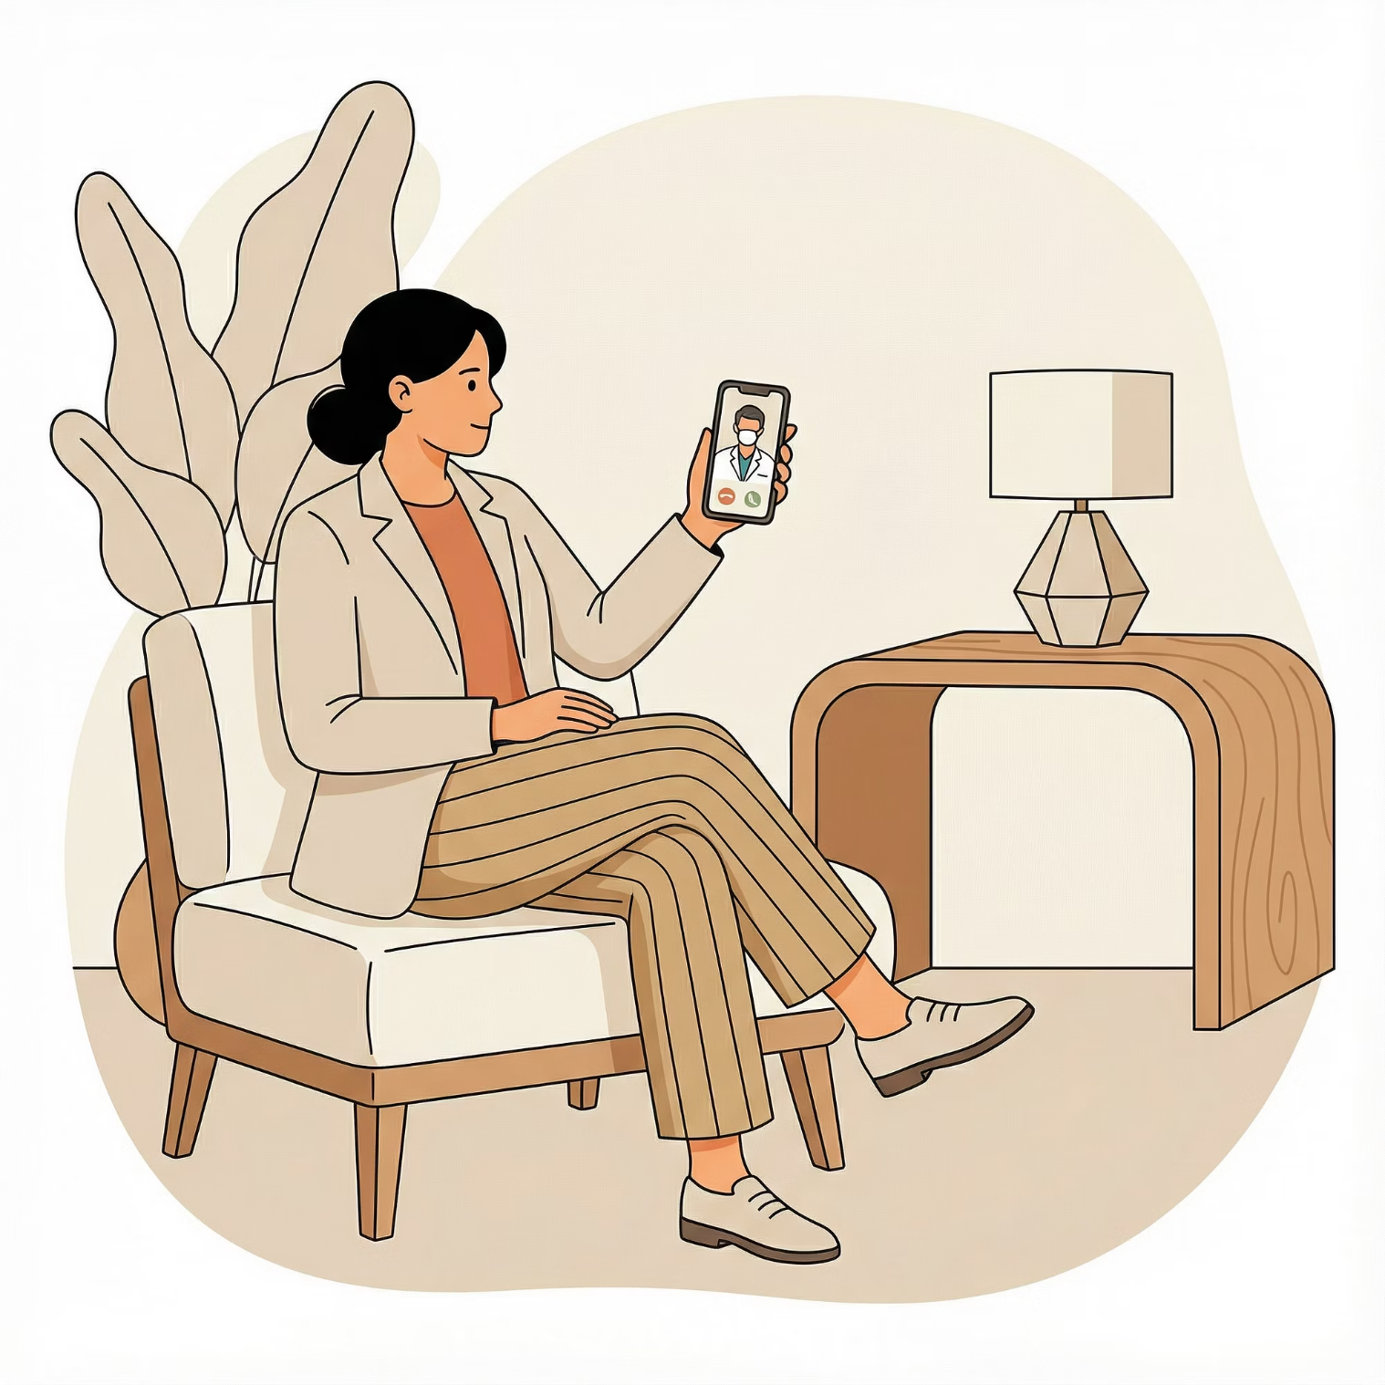
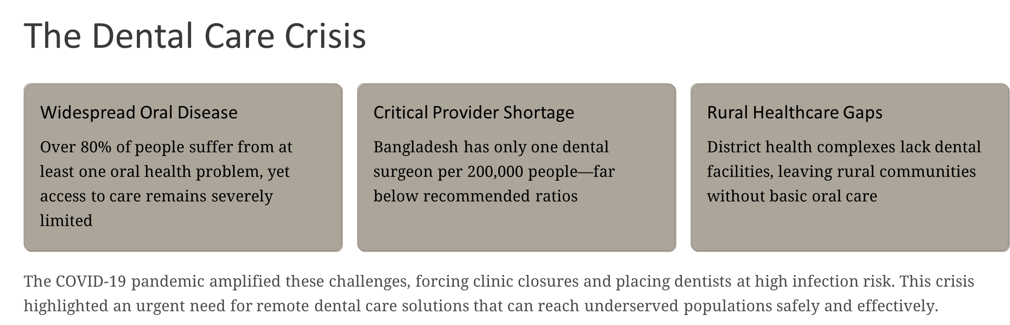

Slide 3






Product Overview: What is E-Dentist?
E-Dentist is a comprehensive tele-dentistry platform combining web and Android applications to revolutionize dental care delivery in Bangladesh. This integrated solution bridges the gap between patients and dental professionals through technology.
Smart Scheduling
Dual Consultation Modes
Online appointment booking with automated reminders
Real-time video calls and asynchronous store-and-forward consultations
Digital Prescriptions
Interactive 3D Model
E-prescriptions with automated medication reminders
Visual dental structure for accurate symptom identification
Clinic Navigation
Emergency Support
Offline-capable directions to nearby dental facilities
24/7 urgent dental care access
Our Mission: Extend quality dental care beyond physical clinics, especially reaching rural and underserved communities throughout Bangladesh.

Slide 4
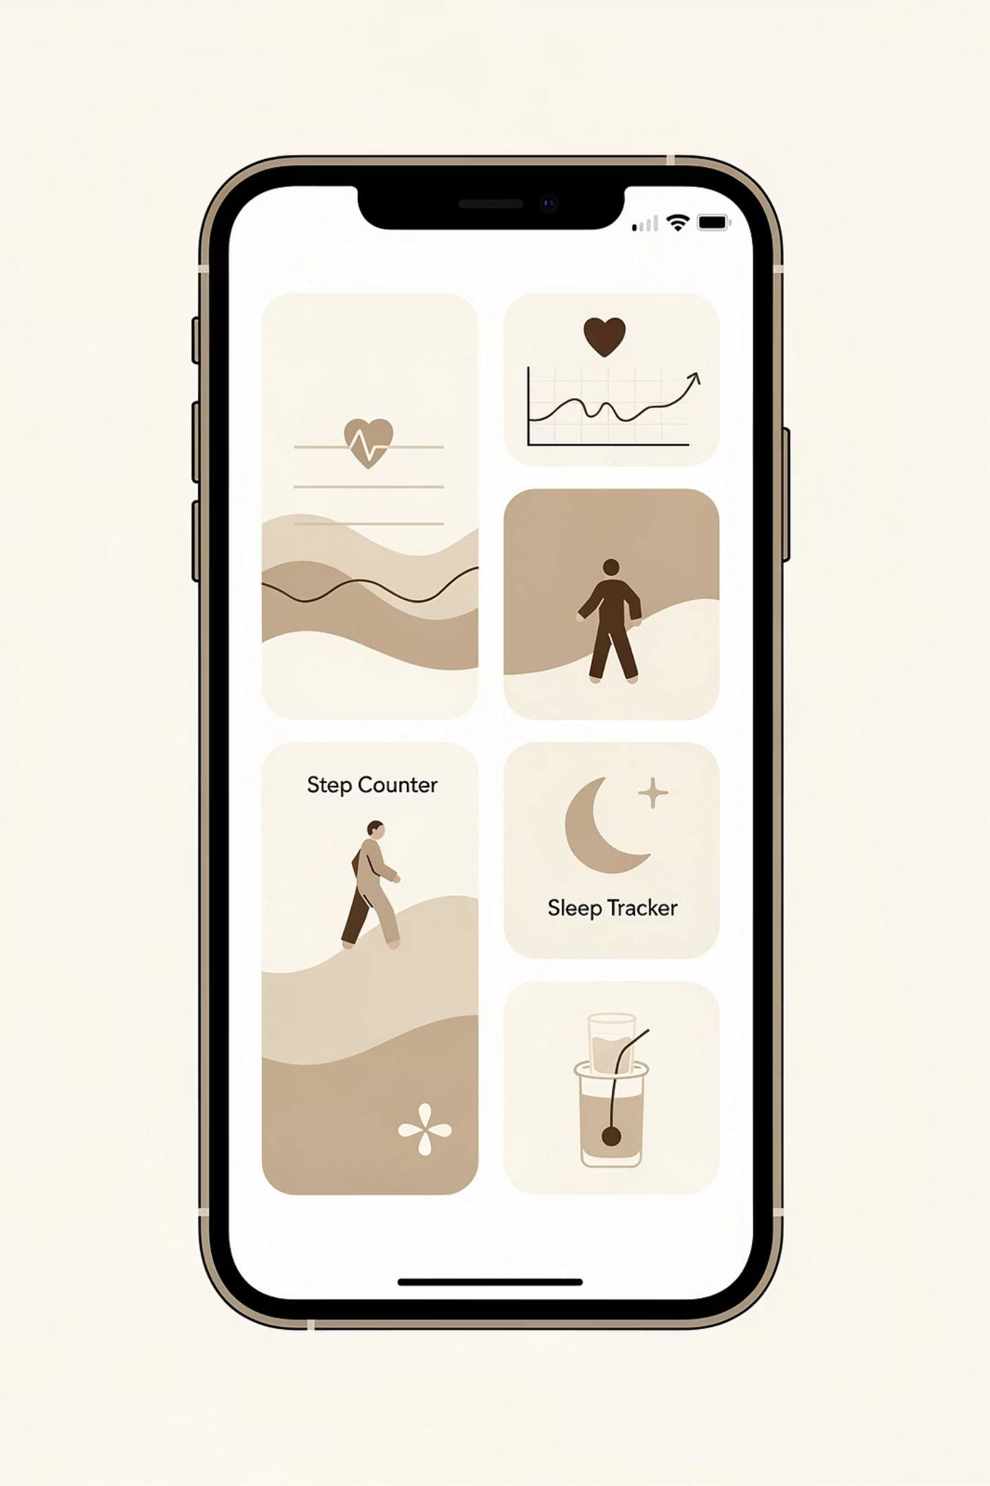


Benchmark: Existing Digital Health Solutions
General Telemedicine Platforms
The Critical Gap
Digital Hospital, Seba Ghar, DocTime and similar platforms offer valuable general health services including video consultations, digital prescriptions, medication reminders, and basic online pharmacy connections. However, these solutions focus on broad healthcare needs rather than specialized dentistry.
While excellent telemedicine foundations exist in Bangladesh, no platform offers an integrated, dental-specific solution that combines risk assessment algorithms, 3D dental visualization, cloud-backed patient records, clinic navigation, and comprehensive tele-dentistry workflows in a single system.
Research-Based Systems
Academic and pilot projects have explored various components: advanced appointment scheduling systems, OCR-based medicine reminder applications, offline navigation to health centers, and Android-based video calling over Wi-Fi networks.

Slide 5
Novelty of E-Dentist
What Sets Our Platform Apart
1
Dental Specialization
Every workflow—from risk assessment to appointments to prescriptions—is specifically tailored for oral diseases and dental care, not adapted from general medicine.
2
Interactive 3D Dental Model
Patients use an intuitive 3D tooth structure to visually identify affected areas, tooth types, and problem locations, eliminating communication barriers.
3
Intelligent Oral Risk Analyzer
Advanced algorithm processes self-reported symptoms and calculates risk levels (low/mild/high) before appointments, enabling appropriate triage.
4
Seamless Service Integration
Complete care pathway: Appointment → Symptom Assessment → Video Consultation → E-Prescription → Automated Reminders → Continuous Oral Monitoring.
5
Offline-Capable Navigation
Helps users locate nearby clinics even with limited connectivity, plus dedicated emergency support features for urgent dental needs.
6
Cloud-Based Multi-Platform Architecture
Central Microsoft Azure backend powers both web and Android platforms, supporting real-time and store-and-forward consultation modes.

Slide 6
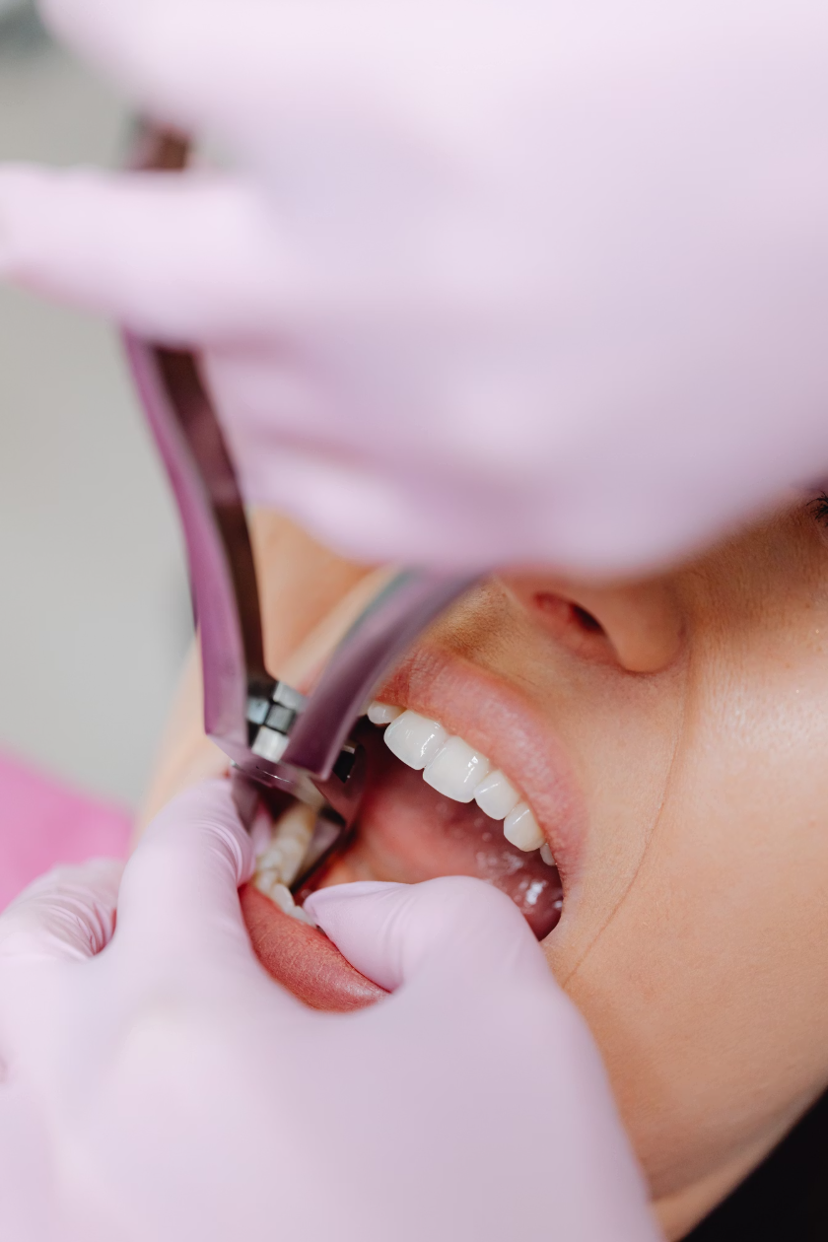




System Architecture & Key Actors
Primary System Actors
Patient / End User
Individuals seeking dental consultations, prescriptions, and oral health monitoring
Dental Professional
Licensed dentists and specialists providing remote consultations and prescriptions
System Administrator
Platform operators managing users, analytics, and system configurations
External System Integrations
Payment gateway services (future scope)
SMS and push notification systems
Map and location-based services
Cloud storage infrastructure (Microsoft Azure)

Slide 7




















High-Level System Modules
E-Dentist comprises ten integrated modules working seamlessly to deliver comprehensive tele-dentistry services:
Admin Dashboard & Analytics
User & Access Management
Emergency Support
Symptom Checker & Risk Assessment
Clinic Finder & Navigation
Oral Health Monitoring
Medication Reminder Engine
Appointment & Scheduling
E-Prescription Management
Remote Consultation

Slide 8



Core Functional Modules: User Management Through Risk Assessment
User & Access Management
Symptom Checker & Oral Risk Assessment
Oral Health Monitoring
Patient registration via phone/email with comprehensive profiles
Periodic self-checkup questionnaires for ongoing assessment
Guided questionnaire capturing pain level, swelling, bleeding, sensitivity, and duration
Dentist registration with license verification and specialization details
Logging of oral health factors: smoking habits, diabetes, hygiene practices
Secure authentication with password reset capabilities
Interactive 3D tooth map for precise location identification
Trend visualization showing risk level changes over time
Role-based access control (patient, dentist, administrator)
Risk calculation algorithm classifying conditions as Low/Mild/High risk
Automated notifications for regular checkups (every 6 months)
Profile management for contact information, photos, and clinic details
Immediate personalized recommendations: monitor at home, schedule routine appointment, or seek urgent care
Deployable for school health campaigns and community programs

Slide 9


Patient Journey: Scheduling Through Consultation
Appointment & Scheduling Module
Remote Consultation & E-Prescription
Patient Features:
Search and filter dentists by specialty, location, language, and patient ratings
View real-time available appointment slots
Consultation Modes:
Book appointments for online or in-clinic consultations
Reschedule or cancel with automated notifications
Synchronous: Real-time video calls between dentist and patient
Receive push notifications and SMS reminders before appointments
Asynchronous: Store-and-forward mode where patients upload photos/X-rays for later review
Dentist Dashboard: Comprehensive appointment list with status tracking (new, confirmed, completed, missed)
In-session chat and secure file exchange capabilities
E-Prescription System:
Comprehensive electronic prescriptions including medicines, dosage, frequency, and duration
Clinical notes and formal diagnosis documentation
Generates readable PDF format for patients
Automatic integration with medication reminder schedule

Slide 10
Supporting Features: Reminders, Navigation & Emergency Care
Medication Reminder Engine
Clinic Finder & Offline Navigation
Emergency Support System
Intelligent Parsing: Automatically extracts prescription details and generates personalized schedules with time-based reminders organized by day and dose.
Comprehensive Directory: Lists nearby dental clinics from locally cached database with complete details including address, distance, phone numbers, and working hours.
24/7 Availability: Round-the-clock hotline and emergency teleconsultation access for urgent dental situations.
Quick Connect: Dedicated emergency button within the app for immediate assistance.
Multi-Channel Notifications: Push notifications with SMS support (future enhancement) ensure patients never miss a dose.
Offline Capability: Functions with minimal bandwidth by caching clinic data and providing basic map navigation even without internet connectivity—critical for rural areas.
Smart Context: Automatically provides on-call dentists with patient ID, medical history, and latest risk assessment information for faster, more informed emergency care.
Missed Dose Logic: Smart handling of skipped medications with appropriate follow-up reminders.
E-Dentist represents a comprehensive solution addressing Bangladesh's dental care challenges through innovative technology, making quality oral healthcare accessible to all communities regardless of location or connectivity constraints.

Slide 11
Functional Requirements Overview
The E-Dentist system comprises ten core functional requirements that define the essential capabilities and features of the platform. Each requirement has been carefully designed to address specific user needs whilst ensuring system coherence and scalability.
FR ID
Requirement Title
Priority
FR01
User Registration & Profile Management
Critical
FR02
Authentication & Secure Login
Critical
FR03
Symptom Entry & Risk Score Calculator
High
FR04
Intelligent Triage Recommendations
High
FR05
Online Appointment Booking System
Critical
FR06
Video Consultation Platform
High
FR07
Digital Prescription Generation
Medium
FR08
Automated Reminder & Notification System
Medium
FR09
Emergency Access Override
High
FR10
Admin Dashboard & Reporting
Medium

Slide 12

FR01
User Registration & Profile Management
Description
Dependencies
The system shall provide a comprehensive registration interface allowing patients and dental practitioners to create accounts with role-based access. Users must provide essential identification details, contact information, and relevant medical history. The registration process includes email verification and password strength validation to ensure account security.
Email verification service integration
Database schema for user entities
Authentication framework (FR02)
GDPR-compliant data storage
Acceptance Scenarios
Rationale
Scenario 1: New patient completes registration form with valid details and receives verification email within 2 minutes
Accurate user profiles are fundamental to delivering personalised healthcare services. Patient medical history informs risk assessment, whilst dentist credentials ensure qualified practitioners provide care. Secure registration prevents unauthorised access and maintains data integrity across the platform.
Scenario 2: Dentist registration includes professional licence validation and clinic affiliation
Scenario 3: System rejects registration attempts with duplicate email addresses

Slide 13

FR02
Authentication & Secure Login
Description
Dependencies
The system shall implement multi-factor authentication supporting password-based login, biometric verification, and optional two-factor authentication via SMS or authenticator apps. Session management includes automatic timeout after 30 minutes of inactivity and secure token refresh mechanisms. Password recovery follows industry-standard security protocols with time-limited reset links.
User registration system (FR01)
Encryption libraries for secure storage
SMS gateway for two-factor codes
OAuth integration for social login options
Acceptance Scenarios
Rationale
Scenario 1: User logs in with valid credentials and receives access within 3 seconds
Healthcare data requires the highest level of security protection. Robust authentication prevents unauthorised access to sensitive patient records and ensures only verified users can book appointments or access consultation features. Multi-factor authentication significantly reduces the risk of account compromise.
Scenario 2: Failed login attempts (5+) trigger account lockout and security notification
Scenario 3: Password reset link expires after 24 hours and cannot be reused

Slide 14
FR03
Symptom Entry & Risk Score Calculator
Description
Dependencies
The system shall provide an intuitive symptom checker interface where patients describe their dental concerns through guided questions, image uploads, and severity ratings. An algorithmic risk calculator processes inputs to generate a numerical risk score (0-10) categorising urgency as Low, Moderate, or High. The calculator considers pain intensity, duration, accompanying symptoms, and patient medical history.
User profile with medical history (FR01)
Clinical decision support algorithms
Image processing for symptom photos
Database of dental conditions and symptoms
Acceptance Scenarios
Scenario 1: Patient reporting severe tooth pain with swelling receives High risk score (8-10) and immediate booking options
Rationale
Accurate symptom assessment enables intelligent triage, ensuring patients with urgent conditions receive priority care whilst optimising dentist schedules. The risk score provides objective data for appointment prioritisation and helps patients understand the seriousness of their condition, reducing unnecessary emergency visits.
Scenario 2: Routine check-up request generates Low risk score (1-3) with standard appointment slots
Scenario 3: Risk calculator updates dynamically as patient answers additional questions

Slide 15
FR05
Online Appointment Booking System
Description
Dependencies
The system shall enable patients to view available appointment slots across multiple dentists and clinics, filtered by date, location, specialisation, and urgency level. The booking interface displays real-time availability, estimated wait times, and dentist profiles. Patients receive instant confirmation with calendar integration and the ability to modify or cancel appointments with appropriate notice periods.
Dentist availability management system
Risk score calculation (FR03)
Scheduling algorithm engine
Calendar integration APIs
Notification system (FR08)
Rationale
Acceptance Scenarios
Streamlined appointment booking reduces administrative overhead, eliminates phone tag, and empowers patients to choose convenient time slots. Real-time availability prevents double-booking conflicts. Integration with the risk calculator ensures urgent cases receive prioritised scheduling, improving patient outcomes and satisfaction.
Scenario 1: Patient with High risk score sees priority slots within next 24 hours
Scenario 2: System prevents booking conflicts by locking slots during selection process
Scenario 3: Appointment confirmation email includes clinic address, dentist details, and preparation instructions

Slide 16
FR06
Video Consultation Platform
Description
Dependencies
The system shall provide an integrated video consultation platform supporting high-definition video, secure audio, screen sharing, and real-time chat. Dentists can visually assess conditions, provide preliminary advice, and determine if in-person visits are necessary. The platform includes recording capabilities (with consent) for documentation purposes and supports up to 4 participants for multi-disciplinary consultations.
Appointment booking system (FR05)
Secure authentication (FR02)
High-bandwidth infrastructure
HIPAA-compliant video service
Patient consent management
Acceptance Scenarios
Rationale
Scenario 1: Patient joins consultation 5 minutes early and enters virtual waiting room
Remote consultations expand access to dental care, particularly for patients in rural areas or with mobility limitations. Virtual triage reduces unnecessary clinic visits, optimises dentist time, and provides patients with professional guidance without travel costs. Video documentation creates valuable records for treatment planning and follow-up care.
Scenario 2: Video quality automatically adjusts based on available bandwidth without disconnection
Scenario 3: Consultation recording is encrypted and stored in patient record with audit trail

Slide 17
FR07
Digital Prescription Generation & Management
Description
Dependencies
The system shall enable dentists to create, sign, and transmit digital prescriptions directly from the consultation interface. Prescriptions include medication details, dosage instructions, duration, and potential side effects. The platform checks for drug interactions against patient medical history and provides electronic transmission to selected pharmacies. Patients can view prescription history and set medication reminders.
Video consultation platform (FR06)
User medical history (FR01)
Drug interaction database
Electronic signature validation
Pharmacy integration APIs
Acceptance Scenarios
Rationale
Scenario 1: Dentist prescribes antibiotics and system alerts about patient penicillin allergy
Digital prescriptions eliminate transcription errors from illegible handwriting, prevent medication conflicts through automated checks, and streamline pharmacy workflows. Electronic transmission reduces patient wait times and ensures accurate medication dispensing. Prescription history provides valuable data for continuity of care and treatment effectiveness analysis.
Scenario 2: Prescription transmits to pharmacy within 5 minutes of dentist signature
Scenario 3: Patient receives mobile notification with medication instructions and pickup details

Slide 18






Non-Functional Requirements Overview
Non-functional requirements define the quality attributes, performance characteristics, and constraints that ensure the E-Dentist system delivers a reliable, secure, and user-friendly experience. These requirements are critical for system success and user adoption.
Performance
Security
Response times, throughput, and resource utilisation targets
Data protection, encryption, and access control measures
Usability
Reliability
Interface design, accessibility, and user satisfaction
System uptime, fault tolerance, and disaster recovery
Scalability
Legal & Ethical
Capacity planning and growth accommodation
Regulatory compliance and ethical standards

Slide 19
NFR01
System Security & Data Protection
Description
Acceptance Scenarios
The system shall implement comprehensive security measures including end-to-end encryption for all data transmission, AES-256 encryption for data at rest, role-based access control (RBAC), and regular security audits. All sensitive data must comply with GDPR, HIPAA, and relevant healthcare data protection regulations. The system shall maintain detailed audit logs of all data access and modifications, with automatic alerts for suspicious activities.
Scenario 1: Security audit reveals zero unauthorised access attempts succeeded in past quarter
Scenario 2: Encrypted patient data remains unreadable even if database is compromised
Scenario 3: System blocks dentist from accessing patient records outside their assigned cases
Scenario 4: Automated penetration testing identifies and reports vulnerabilities within 24 hours
Rationale
Healthcare data represents one of the most sensitive information categories, requiring the highest security standards. Data breaches can result in severe financial penalties, legal consequences, and irreparable damage to patient trust. Robust security measures protect patient privacy, ensure regulatory compliance, and maintain the integrity of clinical records essential for quality care delivery.
Scenario 5: All API endpoints require valid authentication tokens that expire after 1 hour

Slide 20

NFR02
Performance & Response Time
Description
Acceptance Scenarios
The system shall deliver optimal performance across all user interactions with specific response time targets: page loads under 2 seconds, search results within 1 second, appointment bookings processed in under 3 seconds, and video consultations initiating within 5 seconds. The platform must support 10,000 concurrent users without degradation, with horizontal scaling capabilities to accommodate growth. Database queries shall be optimised with sub-100ms response times for common operations.
Scenario 1: Dashboard loads completely within 2 seconds on standard broadband connection
Scenario 2: System maintains sub-3-second response times during peak usage hours (8am-6pm)
Scenario 3: Video consultation maintains stable connection with less than 100ms latency
Scenario 4: Search for available appointments returns results in under 800ms
Rationale
Scenario 5: System automatically scales to handle 50% traffic spike without manual intervention
Performance directly impacts user satisfaction and system adoption. Slow response times frustrate users, particularly patients in pain seeking urgent care. Fast, responsive interfaces enhance trust and efficiency, whilst scalable architecture ensures consistent performance as the user base grows. Performance optimisation reduces infrastructure costs and improves overall system reliability.

Slide 21
Data Flow Diagram (Level 1)
The data flow diagram illustrates how information moves through the E-Dentist system, showing inputs, processes, data stores, and outputs. This visualisation helps understand system behaviour and identify potential bottlenecks or security concerns.
External Entities
Key Processes
Patient: Provides symptoms, preferences, personal data
1. User Authentication: Validates credentials, issues session tokens
Dentist: Inputs availability, treatment notes, prescriptions
2. Symptom Analysis: Processes patient input, calculates risk scores
Administrator: Configures system, runs reports
3. Appointment Scheduling: Executes algorithm, assigns dentists
Pharmacy: Receives prescription data
Payment Gateway: Processes billing transactions
4. Video Consultation: Manages streaming, records sessions
Data Stores
5. Notification Dispatch: Sends emails, SMS, push notifications
User Database: Stores patient and dentist profiles
6. Prescription Management: Generates, validates, transmits prescriptions
Appointment Database: Maintains scheduling records
Medical Records: Encrypted patient health data
7. Reporting & Analytics: Aggregates data, produces insights
Audit Logs: Security and compliance tracking

Slide 22
Priority-Based Dynamic Scheduling Algorithm
The E-Dentist scheduling algorithm intelligently assigns appointments by balancing multiple factors to optimise patient care and dentist utilisation. The algorithm processes patient risk scores, dentist availability, patient preferences, emergency flags, and load balancing to generate optimal appointment schedules.
01
02
Risk Assessment
Availability Check
Patient risk score from symptom checker determines base priority level
System queries dentist schedules for open slots matching patient requirements
03
04
Priority Calculation
Load Balancing
Algorithm combines risk score, urgency flags, and wait time into composite priority
Workload distribution ensures no dentist is over-scheduled whilst maintaining quality
05
06
Conflict Resolution
Confirmation & Notification
System resolves competing requests using priority scores and patient preferences
Appointments confirmed and all parties receive automated notifications

Slide 23
Algorithm Rules & Priority Scoring
The scheduling algorithm employs a sophisticated point-based system that assigns priority scores based on clinical urgency, patient circumstances, and operational efficiency considerations. These rules ensure patients receive timely care whilst optimising resource allocation.
Risk Level
Priority Points
Scheduling Notes
High (8-10)
+5 points
Same-day or next-day slots prioritised; emergency override available
Moderate (4-7)
+3 points
Within 3-7 days; considers patient preference and dentist specialisation
Low (1-3)
+1 point
Standard scheduling within 2 weeks; routine care pathway
First-time patient
+1 point
Additional time allocated for comprehensive assessment
Follow-up visit
+2 points
Preference for original treating dentist when available
Emergency flag
+7 points
Immediate booking; overrides standard queue; alerts on-call dentist
Workload Adjustment Factor
Priority scores are adjusted by dentist workload coefficient: lightly loaded dentists (0-60% capacity) receive +1 modifier, standard load (61-85%) receives no modifier, and heavily loaded dentists (86%+) receive -2 modifier to promote balanced scheduling.

Slide 24
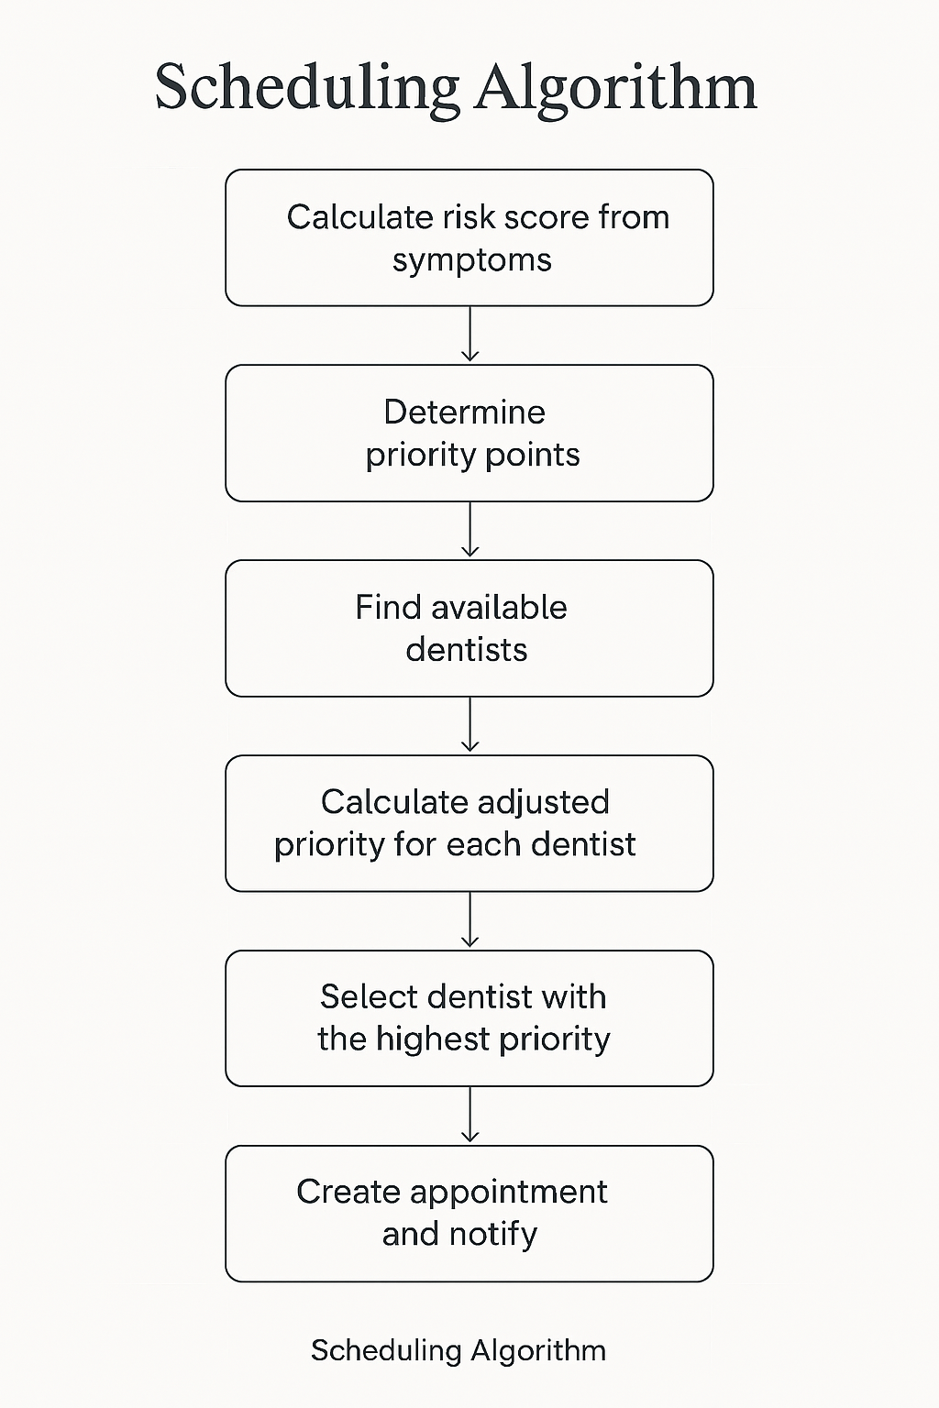
Scheduling Algorithm Pseudo-Code
FUNCTION ScheduleAppointment(patient, requestedDateTime, symptoms): // Step 1: Calculate risk score from symptoms riskScore = CalculateRiskScore(symptoms, patient.medicalHistory) // Step 2: Determine priority points priorityPoints = 0 IF riskScore >= 8 THEN priorityPoints += 5 ELSE IF riskScore >= 4 THEN priorityPoints += 3 ELSE priorityPoints += 1 IF patient.isEmergency THEN priorityPoints += 7 IF patient.isFirstTime THEN priorityPoints += 1 IF patient.isFollowUp THEN priorityPoints += 2 // Step 3: Find available dentists availableDentists = QueryDentistAvailability(requestedDateTime) IF availableDentists.isEmpty() THEN suggestedSlots = FindNextAvailableSlots(requestedDateTime) RETURN suggestedSlots END IF // Step 4: Calculate adjusted priority for each dentist FOR EACH dentist IN availableDentists: workloadFactor = CalculateWorkloadFactor(dentist) dentist.adjustedPriority = priorityPoints + workloadFactor // Add specialisation bonus if applicable IF DentistSpecialisationMatches(dentist, symptoms) THEN dentist.adjustedPriority += 2 END IF END FOR // Step 5: Select optimal dentist selectedDentist = dentist WITH MAX(adjustedPriority) // Step 6: Create appointment and notify appointment = CreateAppointment(patient, selectedDentist, requestedDateTime) SendNotifications(patient, selectedDentist, appointment) RETURN appointment END FUNCTION

Slide 25







Scheduling Algorithm Workflow
Patient Request
Patient submits appointment request with symptoms and preferred time
Availability Check
System queries dentist schedules and identifies potential time slots
Risk Calculation
Symptom checker generates risk score and determines urgency level
Priority Assignment
Algorithm calculates composite priority score with workload adjustments
Conflict Resolution
System resolves competing requests and optimises dentist allocation
Dentist Assignment
Optimal dentist selected based on priority, specialisation, and availability
Notification
All parties receive confirmation with appointment details and instructions

Slide 26
Use Case Diagram
The use case diagram illustrates the primary interactions between system actors (patients, dentists, and administrators) and the core functionalities of the E-Dentist platform. Each use case represents a discrete goal that actors can accomplish through the system.
Patient Use Cases
Dentist Use Cases
Administrator Use Cases
Register and create profile
Register with credentials
Manage user accounts
Log in securely
Manage availability calendar
Monitor system performance
Enter symptoms and receive risk score
View assigned appointments
Generate usage reports
Book appointments
Conduct video consultations
Configure system settings
Join video consultations
Generate digital prescriptions
Review audit logs
View prescription history
Access patient records
Handle support tickets
Receive notifications
Update treatment notes
Manage clinic information
Cancel or modify bookings
Handle emergency requests
Oversee data backups

Slide 27
Appointment Booking Sequence Diagram
The sequence diagram details the temporal flow of messages and interactions between system components during the appointment booking process. This visualises how different layers communicate to fulfil a patient's booking request.
Patient Initiates Request
1
Patient selects preferred date and time through mobile app interface
2
App Queries Backend
Mobile app sends REST API request to backend server with booking parameters
Backend Validates Request
3
Server authenticates request, validates patient credentials, and checks risk score
4
Availability Service Called
Backend queries dentist availability service for matching time slots
Scheduling Algorithm Executes
5
Priority calculation runs to determine optimal dentist assignment
6
Database Transaction
Appointment record created in database with atomicity guarantees
Dentist App Notification
7
Push notification sent to assigned dentist's application with appointment details
8
Confirmation to Patient
Backend returns success response with booking confirmation to patient app
Email & SMS Dispatch
9
Notification service sends confirmation emails and SMS to all parties

Slide 28

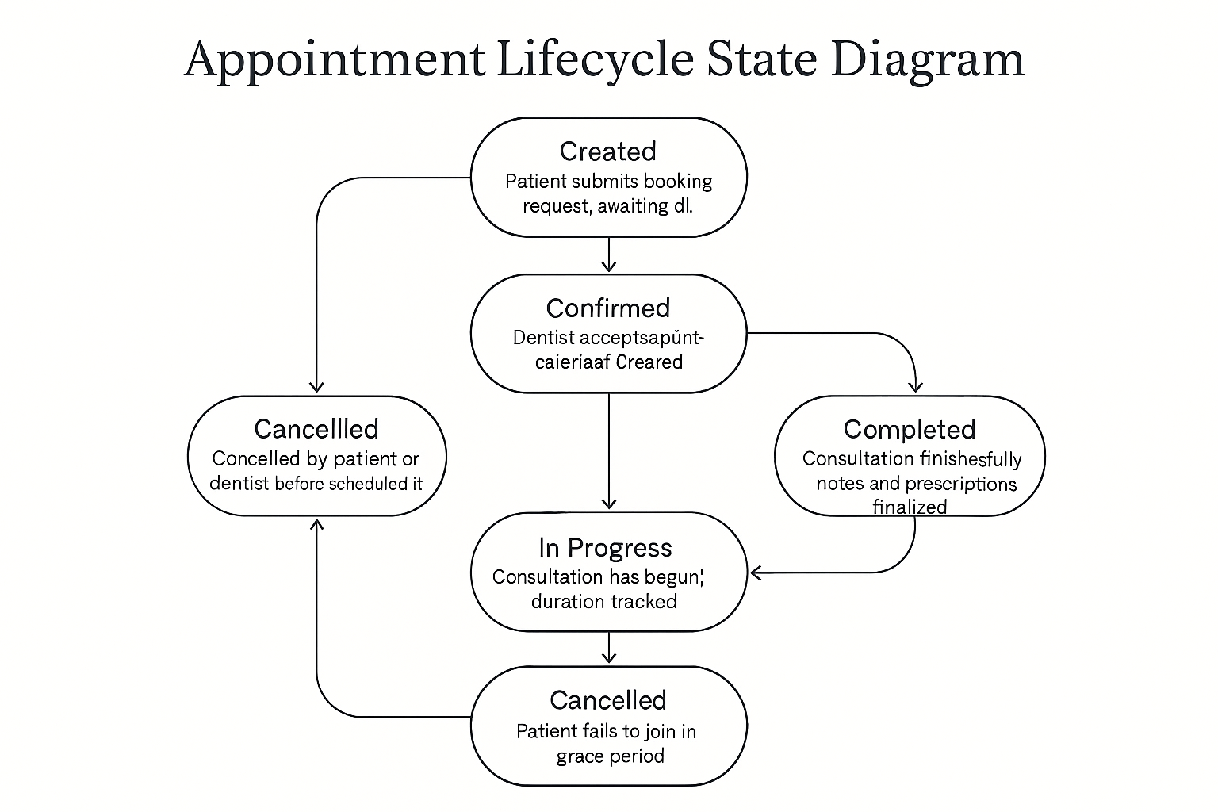





Appointment Lifecycle State Diagram
The state diagram illustrates the various states an appointment can transition through during its lifecycle, from initial creation through completion or cancellation. Understanding these states is critical for managing appointment workflows and handling edge cases.
Created
Initial state when patient submits booking request; awaiting dentist confirmation
Confirmed
Dentist accepts appointment; both parties notified; calendar entries created
In Progress
Consultation has begun; video session active; duration tracked
Completed
Consultation finished successfully; notes and prescriptions finalised
Cancelled
Appointment cancelled by patient or dentist before scheduled time
Missed
Patient failed to join within grace period; slot wasted; follow-up required
State Transition Rules
Created → Confirmed: Requires dentist acceptance within 24 hours
Confirmed → In Progress: Automatic transition when either party joins session
In Progress → Completed: Dentist marks consultation as finished with notes
Created/Confirmed → Cancelled: Allowed with minimum 2-hour notice
Confirmed → Missed: Automatic if patient doesn't join within 15 minutes of start time

Slide 29
Entity Relationship Diagram (ERD)
The ERD defines the database schema, showing entities, attributes, and relationships that form the foundation of the E-Dentist data model. This structure supports all system functionalities whilst maintaining data integrity and enabling efficient queries.
User Entity
Dentist Entity
Attributes: UserID (PK), Email, PasswordHash, FirstName, LastName, DateOfBirth, PhoneNumber, Address, UserType, CreatedDate
Attributes: DentistID (PK), UserID (FK), LicenceNumber, Specialisation, YearsExperience, ClinicID (FK), Rating, AvailabilityJSON
Relationships: One-to-Many with Appointments, SymptomRecords, Prescriptions
Relationships: One-to-Many with Appointments, Consultations, Prescriptions
Appointment Entity
SymptomRecord Entity
Attributes: AppointmentID (PK), PatientID (FK), DentistID (FK), ScheduledDateTime, Status, RiskScore, PriorityScore, CreatedDate
Attributes: SymptomID (PK), PatientID (FK), Symptoms, Severity, Duration, RiskScore, RecordedDate
Relationships: Many-to-One with User, Dentist, Clinic; One-to-One with Consultation
Relationships: Many-to-One with User; One-to-One with Appointment
Consultation Entity
Prescription Entity
Attributes: ConsultationID (PK), AppointmentID (FK), StartTime, EndTime, RecordingURL, Notes, Diagnosis, TreatmentPlan
Attributes: PrescriptionID (PK), ConsultationID (FK), DentistID (FK), PatientID (FK), Medication, Dosage, Duration, Instructions, IssuedDate
Relationships: One-to-One with Appointment; One-to-Many with Prescriptions
Relationships: Many-to-One with User, Dentist, Consultation
Clinic Entity
Reminder Entity
Attributes: ClinicID (PK), ClinicName, Address, PhoneNumber, Email, OperatingHours, Facilities
Attributes: ReminderID (PK), AppointmentID (FK), ReminderType, ScheduledTime, DeliveryMethod, Status
Relationships: One-to-Many with Dentist, Appointments
Relationships: Many-to-One with Appointment

Slide 30





Key Benefits of E-Dentist
E-Dentist transforms dental care delivery, offering significant advantages for both patients and practitioners through its innovative, integrated approach.
Faster Patient Access
Intelligent Triage
Emergency Readiness
Streamlined booking and intelligent matching reduce waiting times, ensuring patients connect with dentists more quickly for timely care.
Our system accurately assesses patient needs, prioritising urgent cases and directing them to the most appropriate dental professional efficiently.
E-Dentist is designed to handle urgent dental situations, providing rapid response and allocation to ensure critical care is always available.
Better Dental Outcomes
Efficient Remote Workflow
Improved continuity of care, timely interventions, and personalised treatment plans lead to superior long-term oral health for patients.
Digital consultations, automated scheduling, and integrated tools optimise dentist operations, reducing administrative burden and increasing productivity.

Slide 31
References
The development of E-Dentist is informed by extensive research in digital health, scheduling systems, and patient care technology. Key sources include:
I. Sherly, R. Sinha, and A. Banerjee, “Online appointment scheduling system with advanced features,” International Journal of Advanced Research in Computer Science, vol. 8, no. 7, pp. 77–82, 2017.
A. Bhadane, P. Patil, and R. Chavan, “Android based medication reminder using ocr and ann,” International Journal of Computer Applications, vol. 123, no. 6, pp. 21–25, 2015.
A. Rahman and S. Karim, “A simple mobile alarm-based medicine reminder system for elderly patients,” in Proceedings of the International Conference on Mobile Computing and e-Health, 2016, pp. 45–49.
M. M. H. Chowdhury, M. H. Rahman, and M. S. Uddin, “mhealth in bangladesh: Current status and future prospects,” Journal of Health Informatics in Developing Countries, vol. 12, no. 2, pp. 1–9, 2018.
P. Deb, T. Rahman, and M. Alam, “Offline navigation system for health services in bangladesh,” International Journal of Computer Science and Information Security, vol. 14, no. 4, pp. 89–95, 2016.
N. Shrideep, K. Patel, and R. Verma, “Android based video calling system over wi-fi,” International Journal of Emerging Trends in Engineering and Development, vol. 4, no. 2, pp. 150–154, 2014.
M. Estai, Y. Kanagasingam, M. Tennant, and S. Bunt, “A systematic review of the research evidence for the benefits of teledentistry,” Journal of Telemedicine and Telecare, vol. 22, no. 6, pp. 323–329, 2016.

